Slide 1

PolicyMe
Graph-Based Corporate Policy Automation & Intelligence System
Ashwak

Slide 2


The Compliance Crisis
Four staggering facts about manual policy management
60%
44%
Manual Management
Assessment Struggles
Companies still rely on spreadsheets for policy compliance tracking
Organizations face challenges with policy assessments and control testing
$4.85M
.
Average Breach Cost
AI Hallucinations
Median financial impact of a data breach in 2025
Misinterpreted policies causing wrongful claim denials and costly errors
Source: Industry compliance reports 2025-2026

Slide 3
Why Current AI Solutions Fail
Three critical failure modes that prevent reliable automated compliance
1. Hallucination Crisis
2. Reactive Approach
3. Black Box Decisions

Slide 4
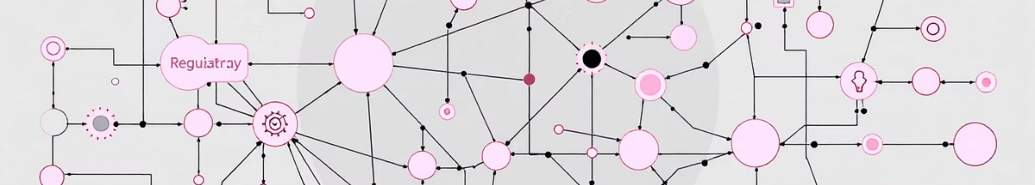



Our Solution: PolicyMe
A Graph-Based Intelligence System
GraphRAG
Active Monitoring
Explainable AI
Zero-hallucination policy interpretation using knowledge graphs instead of keyword matching
Multi-agent system prevents violations before claims are filed
Visual traceable decision paths showing exactly why each coverage decision was made

Slide 5
PolicyMe vs Standard Solutions
Feature
Standard Solutions
PolicyMe
Data Structure
MySQL text storage
Neo4j knowledge graph
AI Method
Direct API wrapper
GraphRAG pipeline
Approach
Reactive dashboards
Active monitoring agents
Transparency
Black box
Visual decision traces
Accuracy
Prone to hallucinations
Zero-hallucination logic

Slide 6
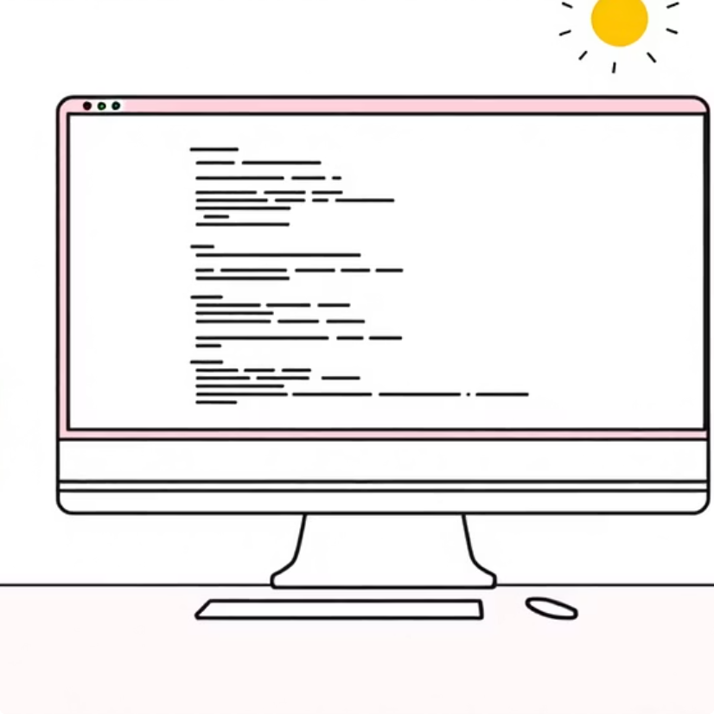
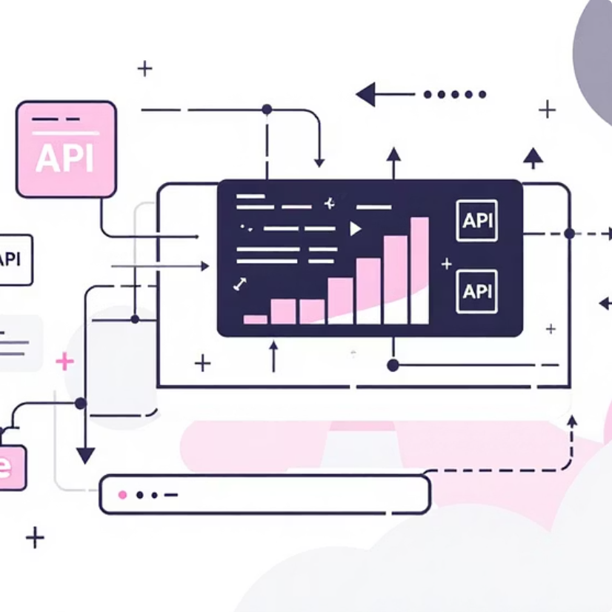



Technical Architecture
Advanced Tech Stack
Frontend
Backend
Database
AI Engine
Next.js + React Flow for interactive graph visualization
Python FastAPI for AI orchestration and request handling
Neo4j Graph Database stores policy logic as connected networks
LlamaIndex + Ollama for privacy-first local processing
Key Advantage
Relationships between policy clauses are preserved as graph edges, enabling mathematical proof of coverage decisions

Slide 7
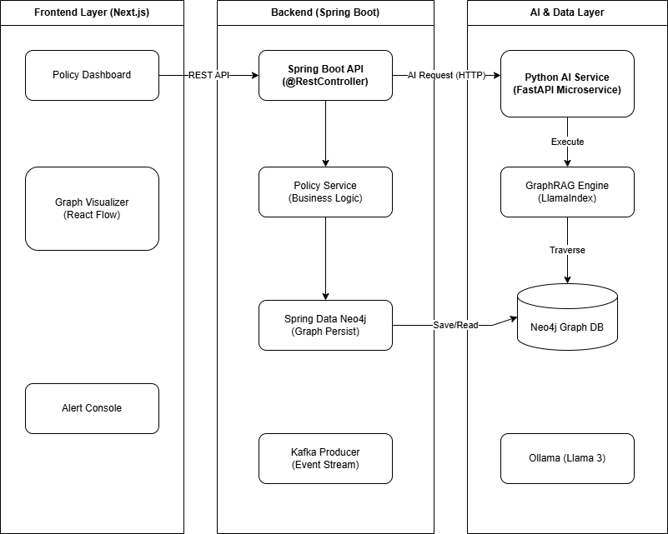
Architectural Diagram

Slide 8
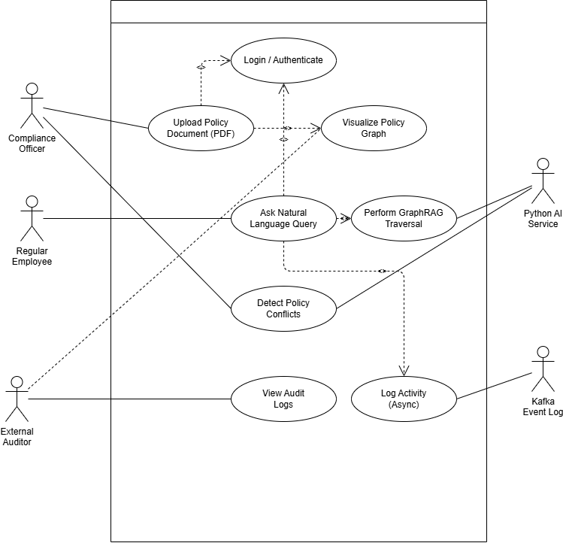
Use Case Diagram

Slide 9
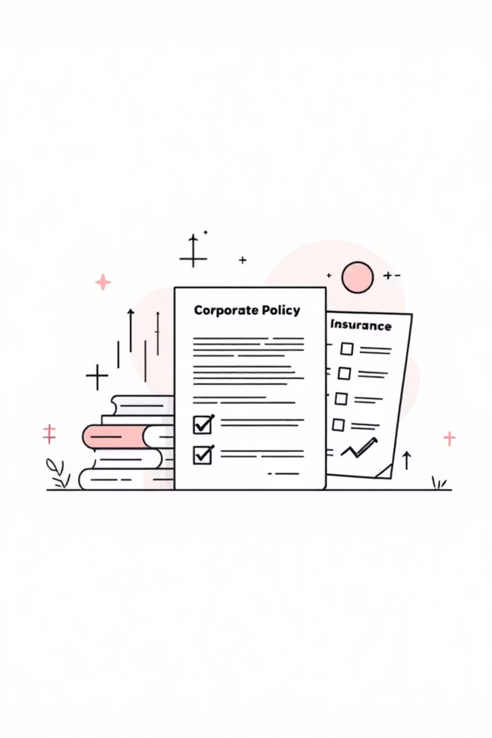




Market Impact
70% Faster Audits
Reduces compliance audit time
Zero Wrongful Denials
Eliminates errors through zero-hallucination logic
Lower Breach Costs
Prevents violations through active monitoring
$12B+ Market
Targets insurance compliance sector

Slide 10

Thank You !
Questions?

